Slide 1
IFTTT Project
Ben Sottile

Slide 2
WTF IFTTT
IFTTT is a service that integrates other applications and surfaces and allows for the automatic integration of apps and services. IFTTT is short for IF This Then That which is how the application operates. One event the directly triggers an event in another application.

Slide 3
Ifttt applets
Log Work Hours into google Sheets with button
Get out of awkward situation with voip call
Take quick notes and email self.
Bonus Surprise Applet

Slide 4
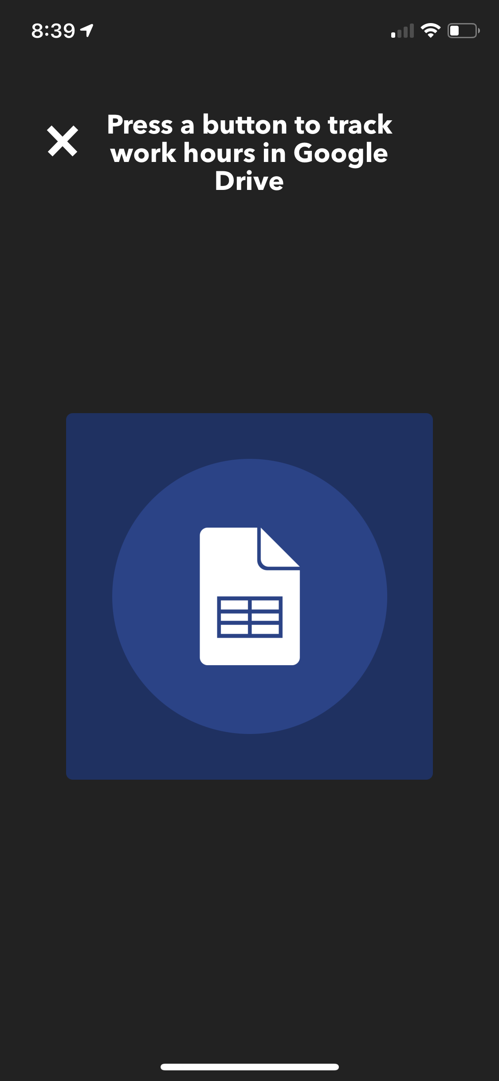
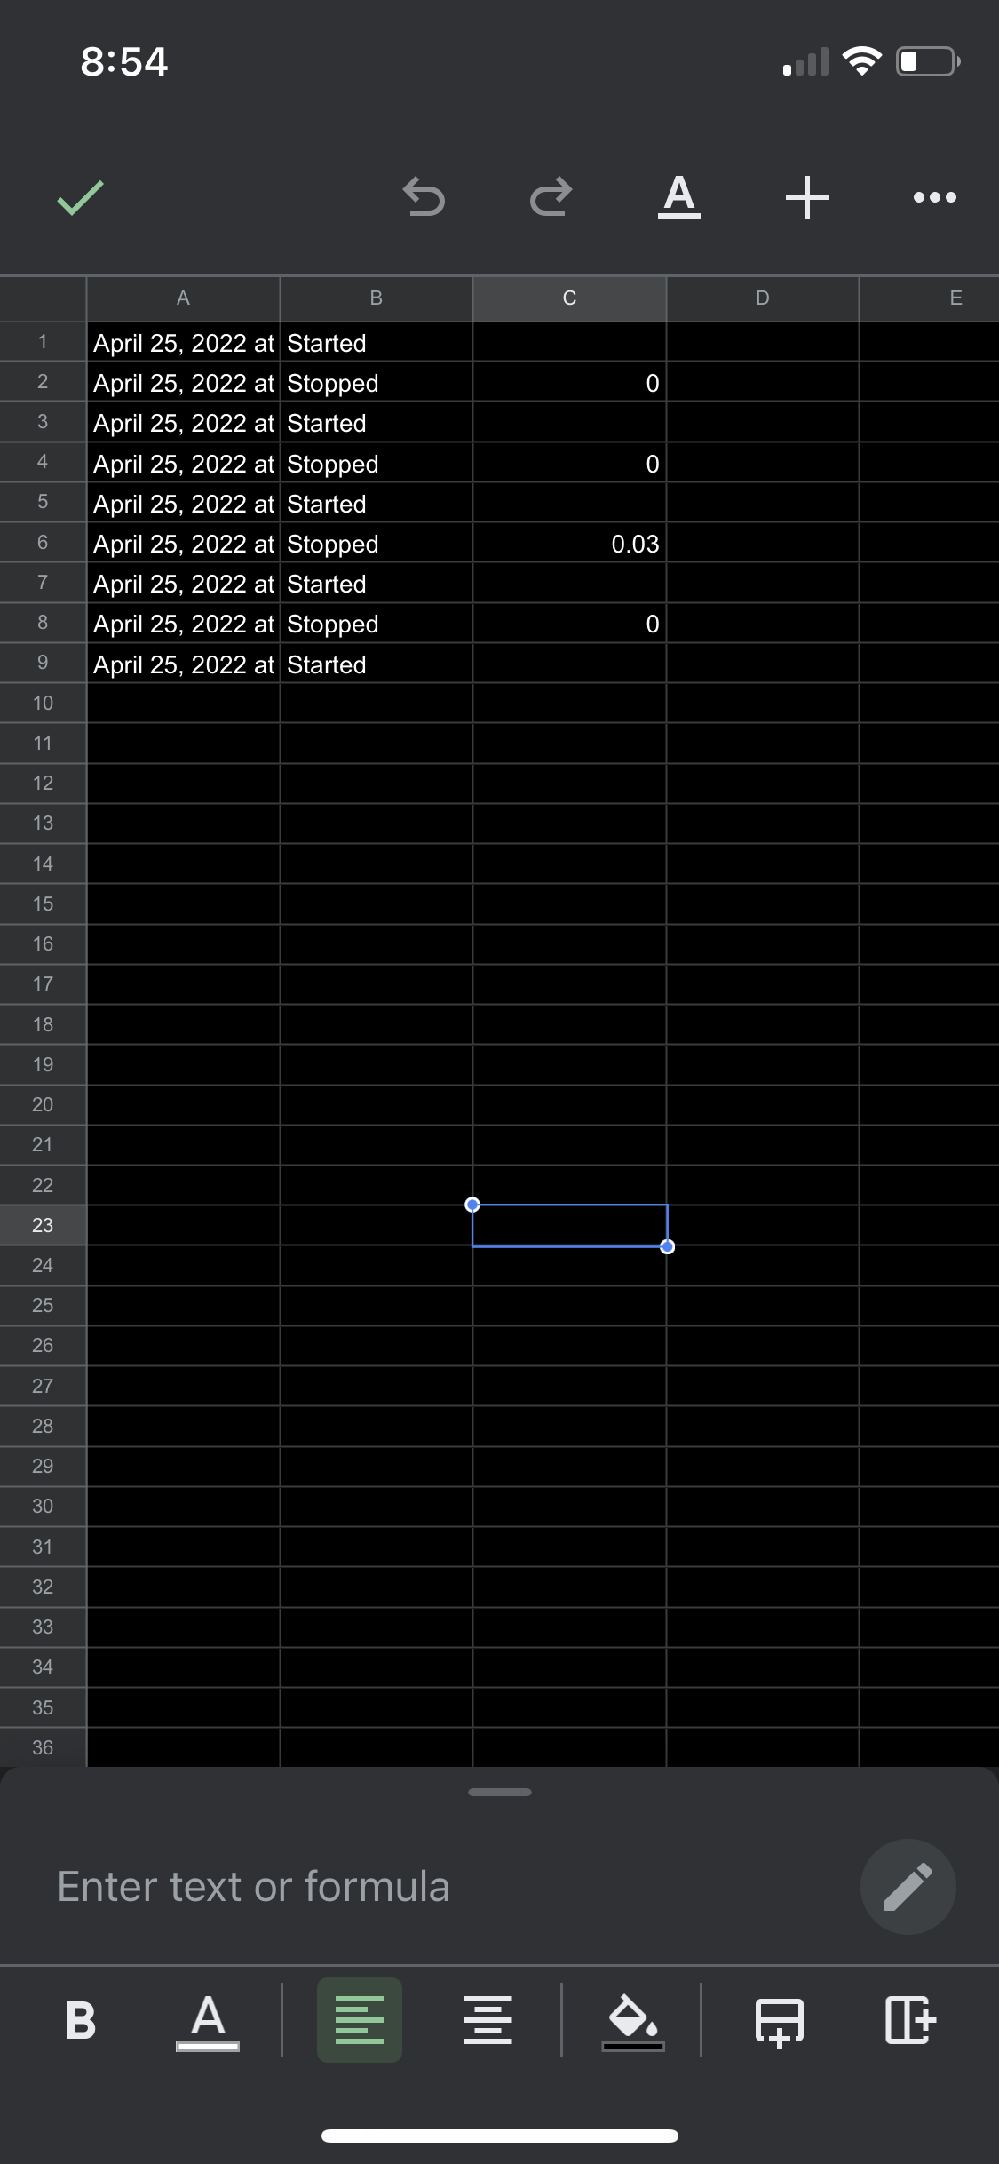
Log Work Hours Into Google Sheets
Hours are logged with start and stop of button.
Did not list the specific timestamp and just gave a number.

Slide 5
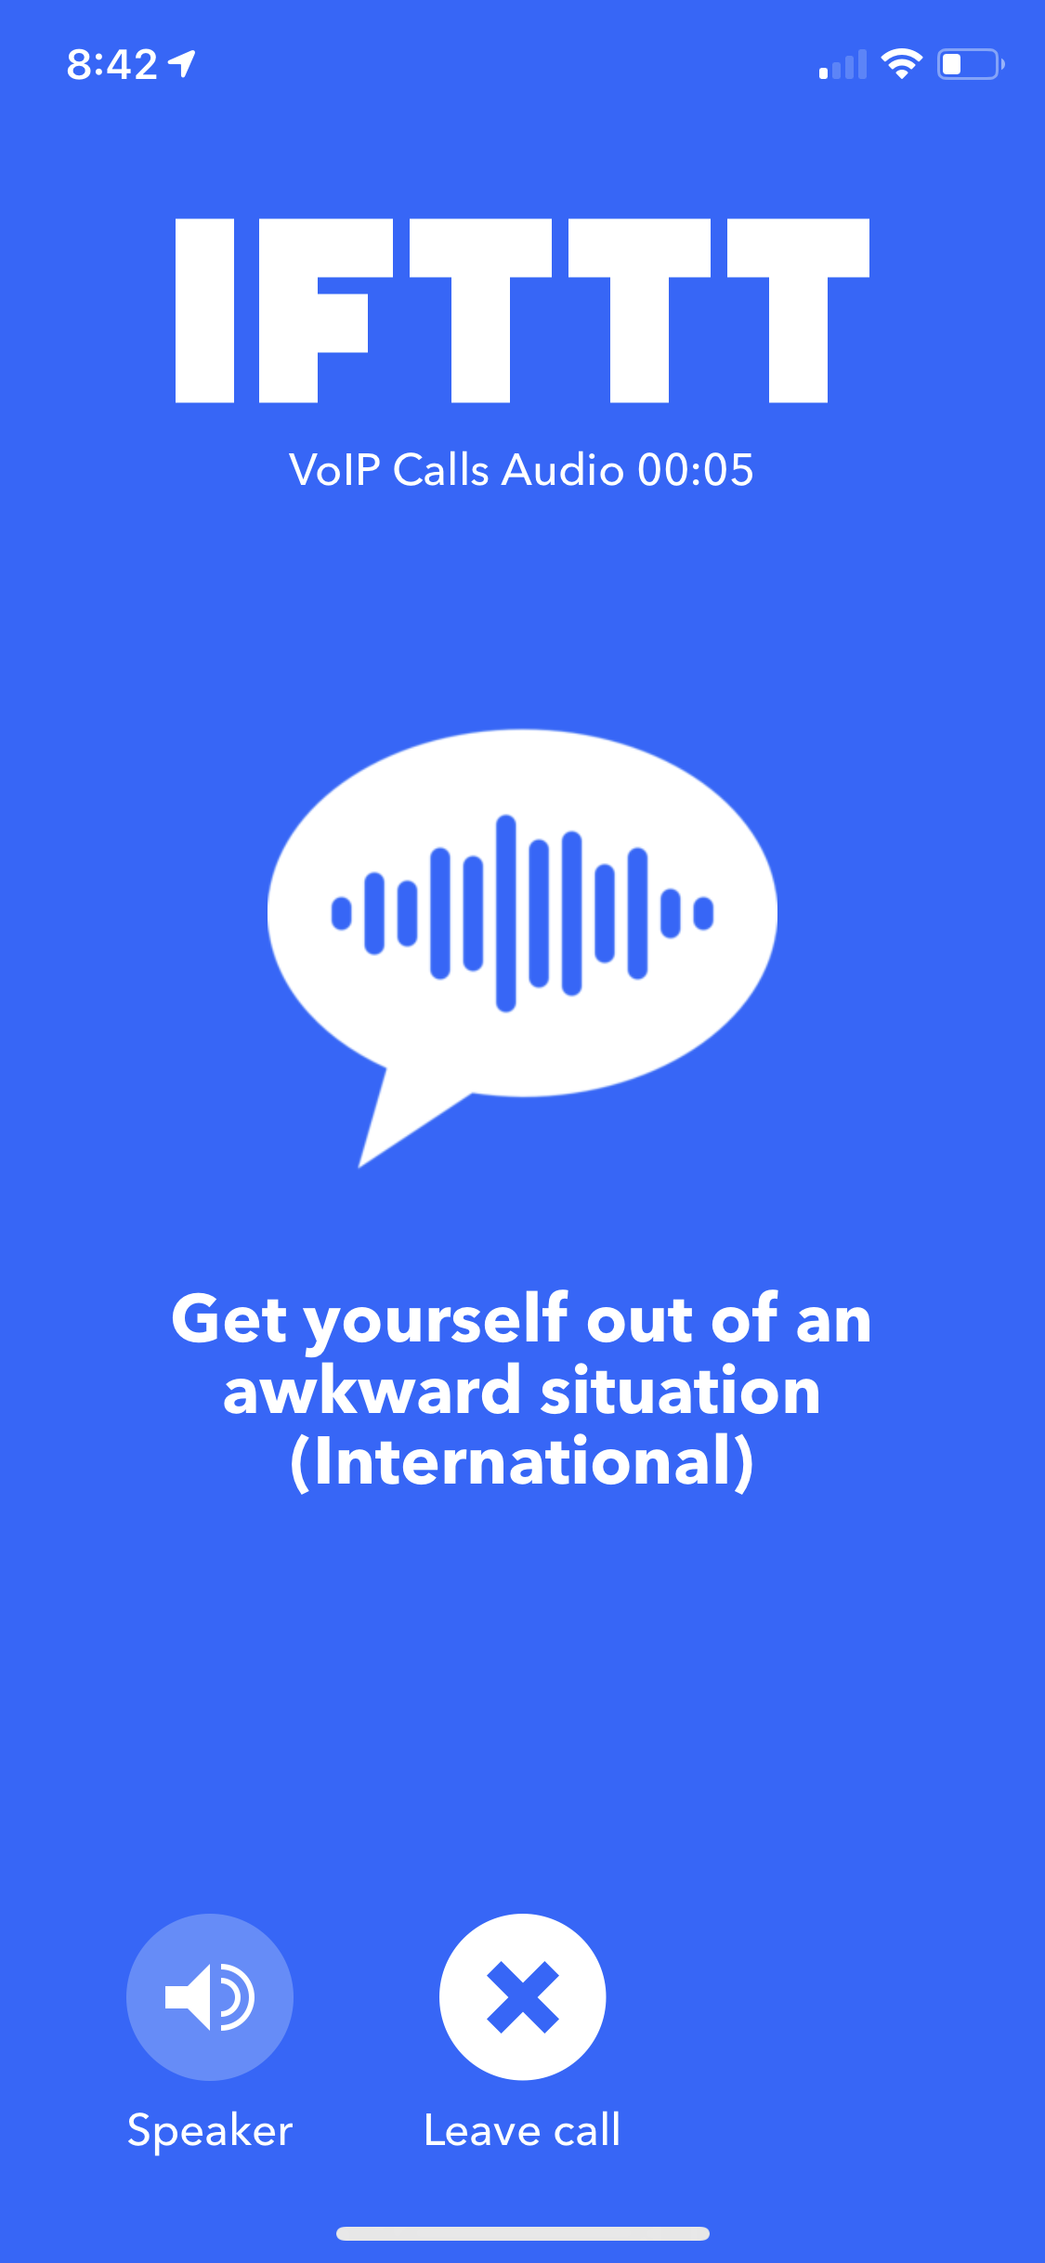
Get out of awkward situation with voip call
I mean it works right? But don’t let anyone actually see your phone screen.

Slide 6
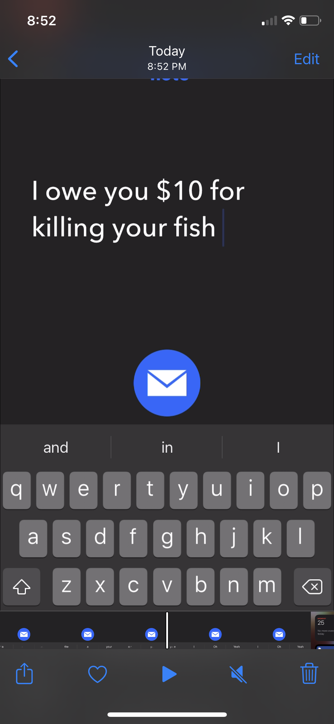
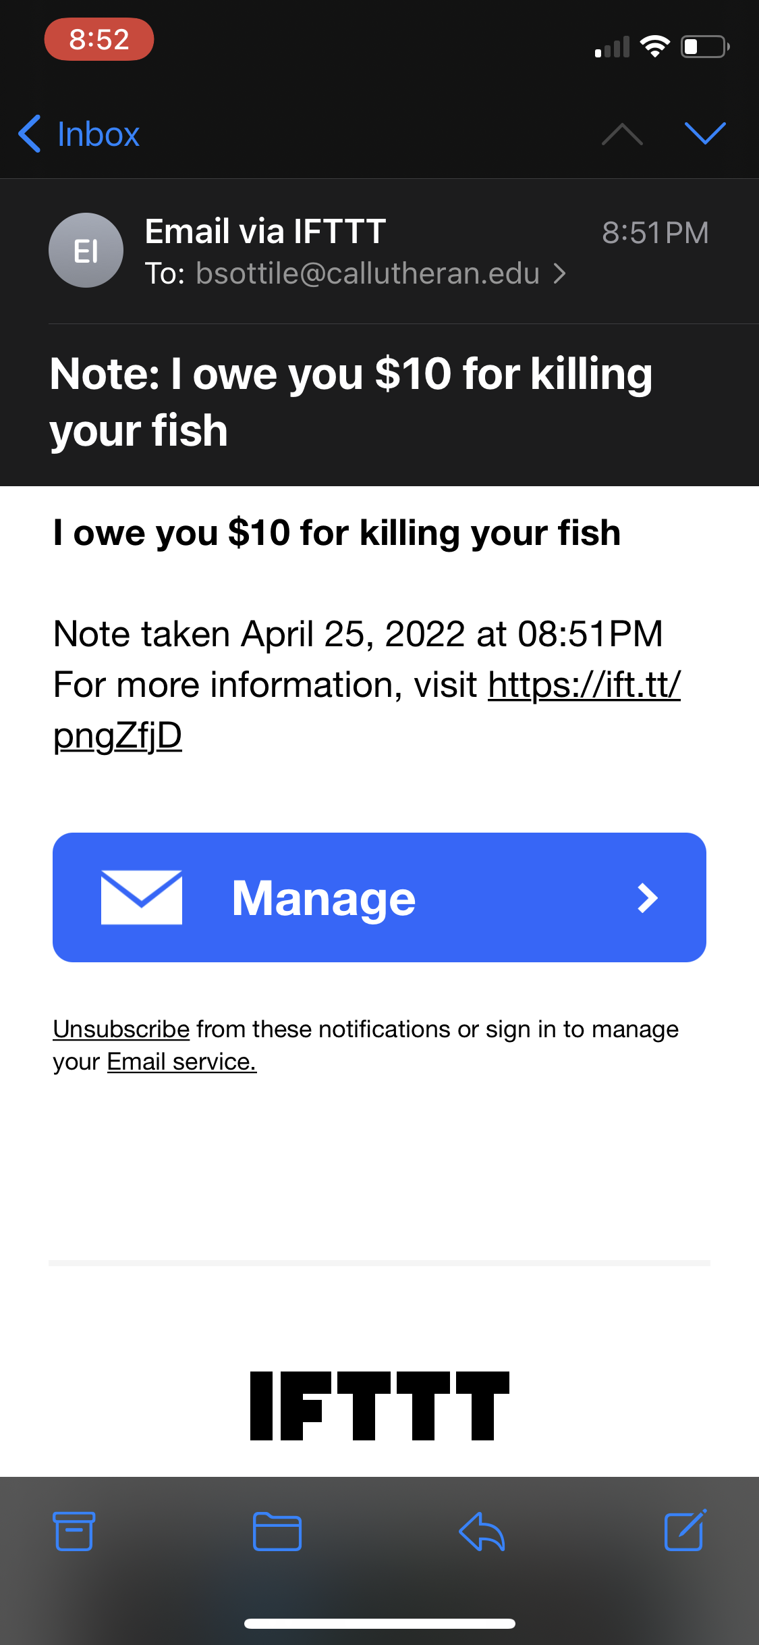
Take quick notes and email self.

Slide 7
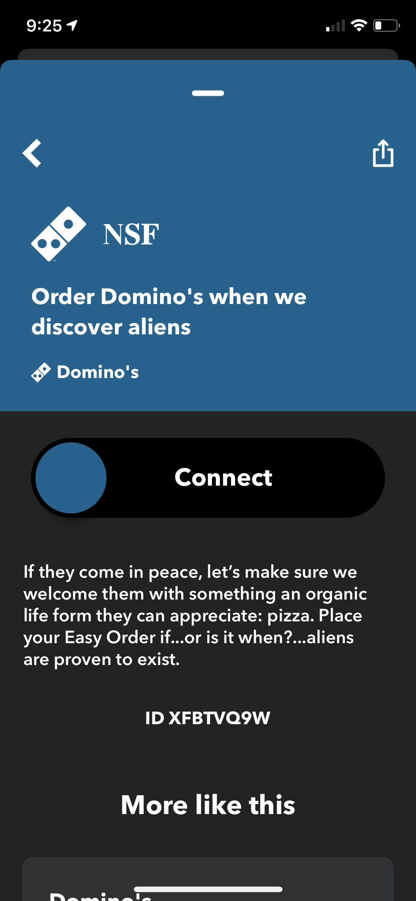
Bonus Applet:

Slide 8
3 IFTTT Alternatives
Zappier
Automate.io
Make

Slide 9
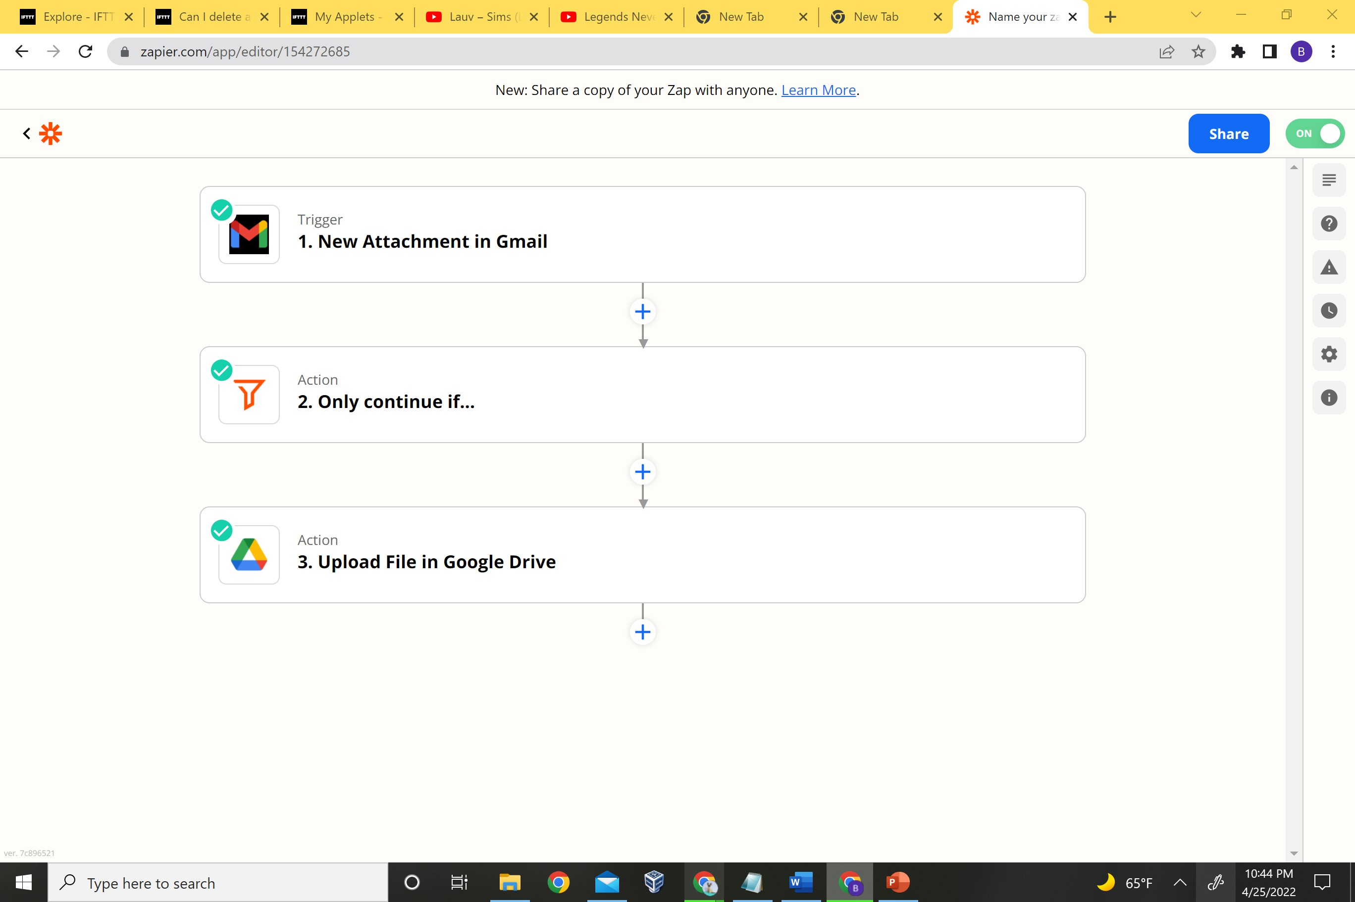
Zappier
Applet: Send email via Automatically add all gmail attachments to google drive
Works like a dream
A lot more set up but way more functionality

Slide 10
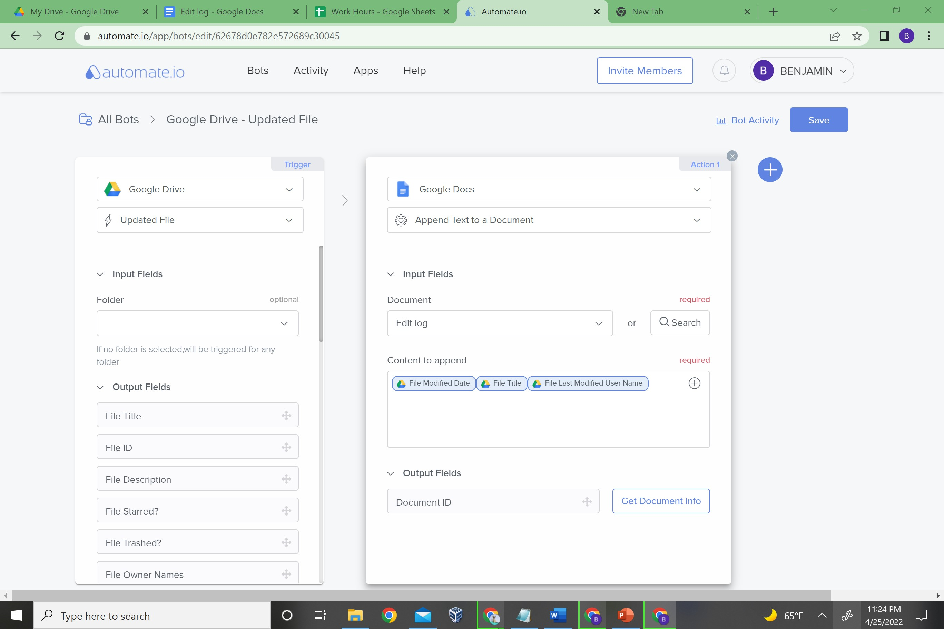
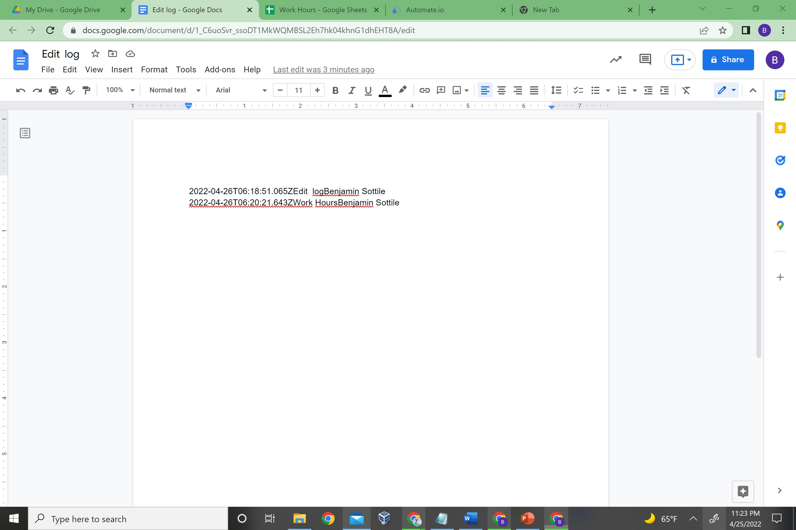
Automate.io
Applet: Log the date files are modified, the file, and the user who modifed it

Slide 11
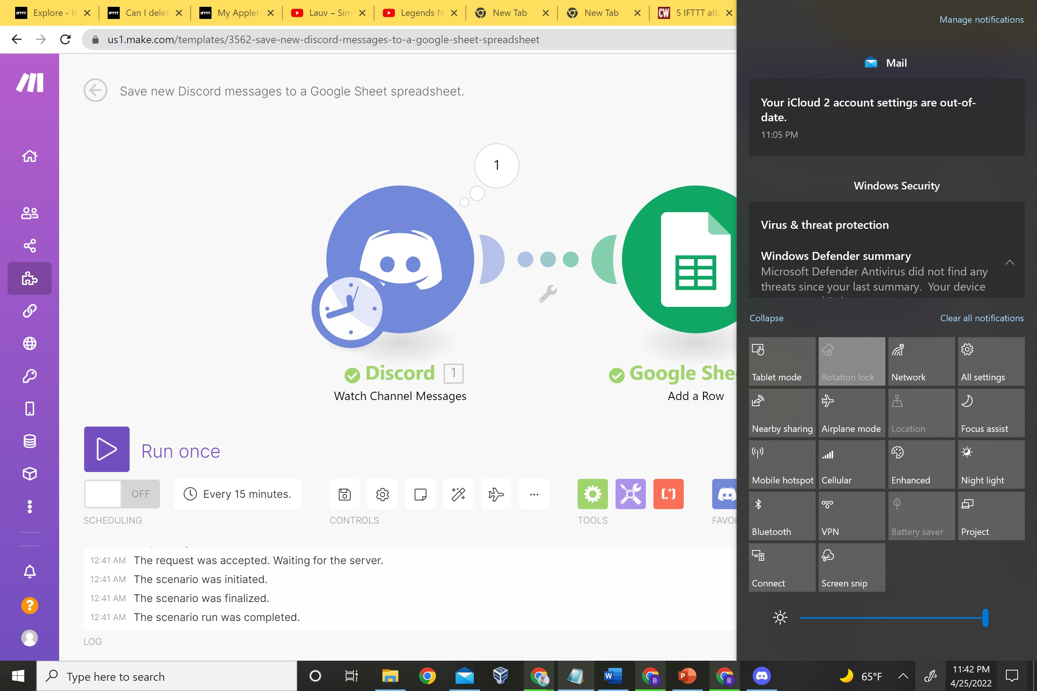
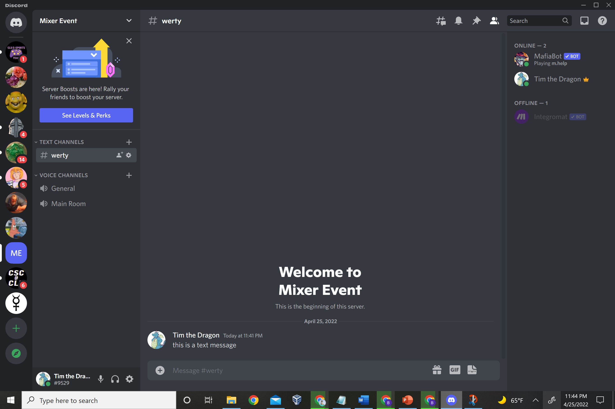
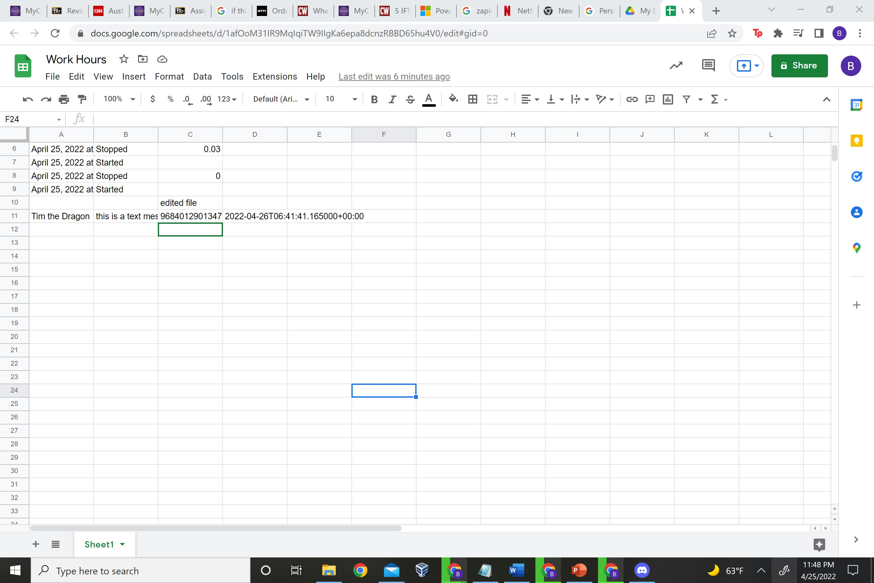
Make
Applet: Update google sheets every time a new discord message is added

Slide 12
Recommendation
Zappier
It was all around a better experience and I was able to use there tools pretty well.
More tuned to my needs
Easy to use but not simple in function

Slide 13
Sources
https://www.computerworld.com/article/3393177/5-ifttt-alternatives-worth-trying.html
https://ifttt.com/explore/new_to_ifttt

